Slide 1
Linear Equations in Linear Algebra
1.7 Introduction to Linear Transformation
Bumhee Cho

Slide 2
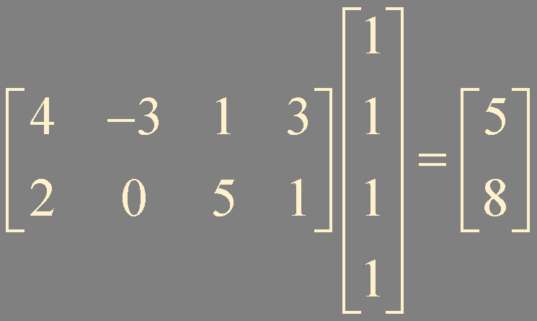
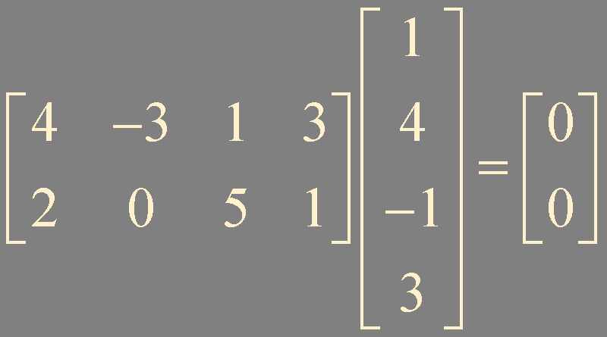





Matrix Multiplication
ℝ⁴
ℝ²

Slide 3






Transformation
A transformation (or function or mapping) from ℝ^{n} to ℝ^{m}
is a rule that assigns to each vector in ℝ^{n}
a vector in ℝ^{m}
ℝ^{n}
ℝ^{m}
image of
range of
Domain
Codomain

Slide 4



Matrix Transformation
ℝ^{n}

Slide 5

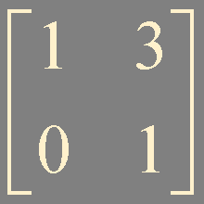
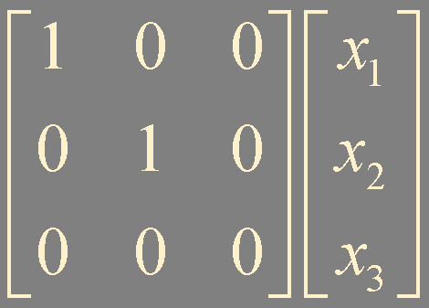
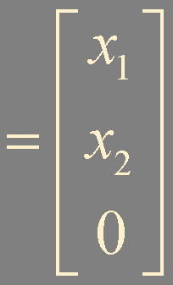
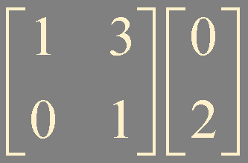
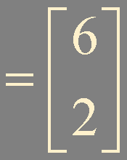
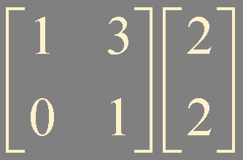
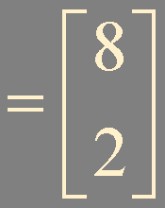

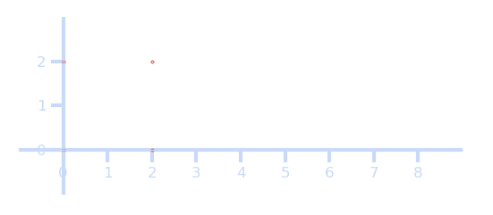


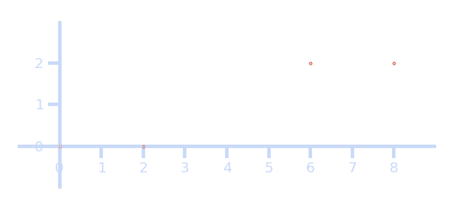
Example 1.

Slide 6


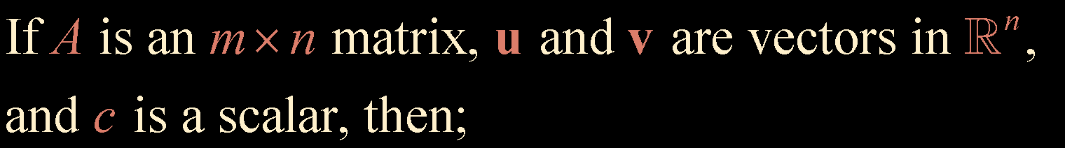


Linear Transformation
A transformation (or mapping) is linear if
Theorem 5.
Every matrix transformation is a linear transformation

Slide 7
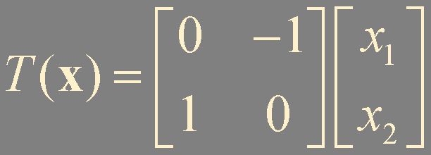
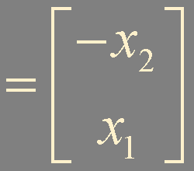
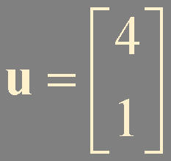
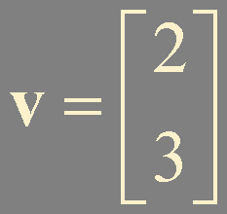
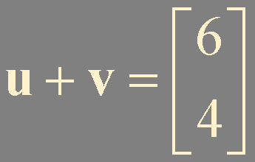

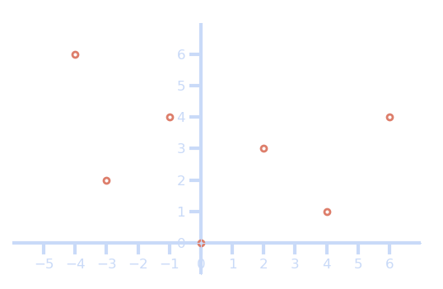





Example 2.

Slide 8
Summary
transformation
matrix transformation
linear transformation

